Slide 1

Embryological aspects of Implantation Failure
Dr. Shirzad Hosseini
Shiraz Fertility Center

Slide 2


Defining RIF in ART (Eshre 2023)
In the population:
  Transfer of embryos considered to be viable has failed to result in a positive pregnancy test sufficiently often in a specific patient to warrant consideration of further investigations and/or interventions.
In the individual:
  Determination of what cumulative chance they have had to conceive thus far.
  The recommended threshold for the cumulative predicted chance of implantation to identify RIF to initiate further investigation is 60%.
  If this is greater than an agreed threshold, but no positive pregnancy test has been achieved, then action may be indicated.

Slide 3
Implantation Failure
Female-related factors:
  Age, hormonal levels, endometrial and uterine status, and underlying conditions
Embryo-related factors:
  Embryonic cleavage speed, euploidy, and previous implantations of sibling embryos
Male factors:
  Genetic disorders
External factors:
  The performance of the laboratory and clinic
  Transfer policies
  Legal restrictions

Slide 4
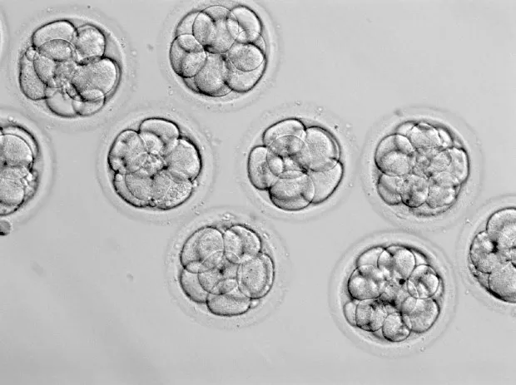
What is a GOOD Embryo?
Embryo selection methods:
  Non-invasive:
    Conventional grading system
    Time lapse technology
    Spent culture media analysis (analysis of embryo physiology and function)
  Invasive:
    Embryo biopsy & PGT

Slide 5
    Conventional grading system
Cleavage embryo grading:
Embryo selection criteria based on cell number and morphology
Sakkas and colleagues therefore used cleavage to the 2-cell stage at 25 hours post-insemination or microinjection as the critical time point for selecting embryos
Blastocyst grading
Gardner and Schoolcraft (3.A.A)
Alpha Scoring System (3.1.1)
Demerits:
Subjective, dynamic, don’t reflect genetic status
Notes:
Many laboratories select embryos by morphological criteria, with the use of a semi-quantitative scoring system based on the number of blastomeres and embryo quality.
The results are inconsistent and do not necessarily reflect the implantation potential of the embryo. Inconsistency is due to the subjectivity of the evaluation, as well as to variations in the timing of assessment.

Slide 6
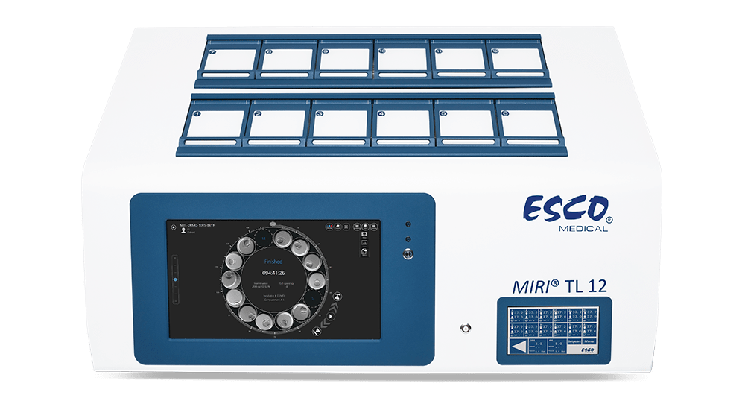
Time-Lapse Imaging to Assess Embryo Morphokinesis
Payne et al, 1997.
The main advantages of these systems are
  Improved and stable cultural conditions
  The determination of objective and accurate markers, both quantitative and qualitative
  Reduced handling and human risk; minimization of culture media, gas, and oil
  Detection of abnormal events that would normally occur between observations
  Reduced inter- and intra-observer variability
  Reduced number of hours needed by the embryologist in the laboratory

Slide 7
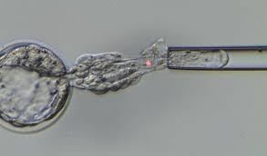
Preimplantation genetic testing for aneuploidies
Aneuploidy accounts for implantation failure and early pregnancy loss, as high as 76% in first-trimester spontaneous abortions.
PGT-A is a technology that can analyze the chromosomes of embryos in IVF-ET and select euploid embryos for subsequent transfer.
Single euploid embryos selected by array comparative genomic hybridization were transferred to patients with RIF, which resulted in implantation rates like those in the group without RIF.
PGT-A appears to be a considerable treatment option for patients with RIF.
Notes:
The cumulative implantation rate of patients with RIF who underwent euploid embryo transfer was 95.2%, which means that most RIFs are due to chromosome aneuploidy and can be improved by transferring euploid embryos.

Slide 8
Blastocyst euploidy rate

Slide 9
Notes:
Options for the non-invasive analysis of human embryo nutrient consumption and metabolite/factor production. Individual blastocysts are incubated in 5.0 to 50.0 µL volumes of defined medium. Serial or end point samples of medium can then be removed for analysis and an indirect measurement of metabolic pathways can be ascertained by measuring uptake or production of various factors or using discovery platforms. Non-invasive platforms can also include current morphology and cleavage criteria using static or time-lapse measurements. Semi-non-invasive platforms are also under development using novel microscopy platforms or examining the blastocoelic fluid.

Slide 10
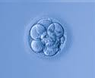
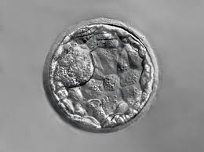
Stage of Embryo
Blastocyst vs. Cleavage stage??

Slide 11
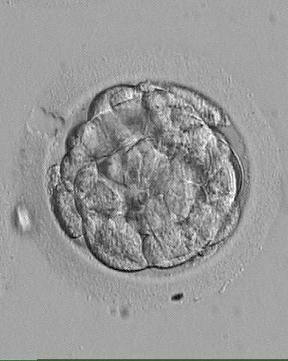
Assisted hatching
Assisted hatching (AH) is a technique that includes zona thinning and zona drilling/opening, using chemical, mechanical, or laser energy.
A recent meta-analysis showed that it was uncertain of the effect of AH on live birth rates. In selected patients such as those with RIF, AH might be beneficial.
ASRM considered that there is insufficient evidence for the benefit of AH
In patients with RIF older than 38 years, AH caused by partial zona dissection led to a significant increase in implantation and clinical pregnancy rates.

Slide 12
Sequential embryo transfer
First introduced by Abramovici et al. (1988)
Comprises two stages of embryo transfer on separate days within the same treatment cycle—specifically, the first transfer occurs on the second day post-oocyte retrieval, and the second on the third day.
This approach capitalizes on the “implantation window,” enhancing endometrial receptivity.
Goto et al. (2005) refined the technique by
Initiating the first transfer with a cleavage-stage embryo, followed by a blastocyst for the second transfer.
This modified protocol mitigates the risk of cycle cancelation due to failed blastocyst formation and yields superior implantation and pregnancy rates compared to conventional transfer methods

Slide 13
Mixed double embryo transfer
Two embryos:
  1 cleavage-stage
  1 blastocyst stage
All embryos were transferred 5 days after ovulation

Slide 14
RIF management guidelines
Eshre 2023 | ASRM | CFAS 2020 | BFS 2020
Review of estradiol treatment if the endometrium remains thin | - | Karyotype testing | Lifestyle changes | Surgery for submucous fibroid
PGT and Genetic counseling |  | Preimplantation genetic testing for aneuploidies | Ultrasound guided embryo transfer | Salpingectomy for hydrosalpinx
Optimization of lifestyle factors |  |  | Full bladder at embryo transfer | Treatment for subclinical hypothyroidism
 |  |  | genetic counselling | Endometrial polypectomy

Slide 15


